Slide 1

Citizenship in the Nation
Troop 344 and 9344
Pemberville, OH

Slide 2
Citizenship in the Nation Merit Badge Requirements
What is the Constitution of the United States? What does the Constitution do? What principles does it reflect? Why is it important to have a Constitution?
List the six purposes for creating the United States Constitution set forth in the Preamble to the Constitution. How do these purposes affect your family and community?
List the three branches of the United States government. Explain:
  The function of each branch of government
  Why it is important to divide powers among different branches
  How each branch "checks" and "balances" the others
  How citizens can be involved in each branch of government.

Slide 3
Citizenship in the Nation Merit Badge Requirements
Discuss the importance of:
  Declaration of Independence
  The Bill of Rights (the first 10 Amendments to the Constitution) and the 14th Amendment
  The traditional United States motto "E Pluribus Unum".
Watch the national evening news for five days in a row or read the main stories in a national media organization (e.g., a newspaper or news website) for five days in a row. Discuss the national issues that you learned about with your counselor. Choose one issue and explain how it affects you, your family, and community.

Slide 4
Citizenship in the Nation Merit Badge Requirements
With your counselor's approval, choose a speech of national historical importance.
Explain:
  Who the author was
  What the historical context was
  What difficulties the nation faced that the author wished to discuss
  What the author said
  Why the speech is important to the nation's history.
Choose a sentence or two from the speech that has significant meaning to you, and tell your counselor why.

Slide 5
Citizenship in the Nation Merit Badge Requirements
Do TWO of the following:
  Visit a place that is listed as a National Historic Landmark or that is on the National Register of Historic Places. Tell your counselor what you learned about the landmark or site and what you found interesting about it.
  Tour your state capitol building or the U.S. Capitol. Tell your counselor what you learned about the capitol, its function, and the history.
  Tour a federal facility. Explain to your counselor what you saw there and what you learned about its function in the local community and how it serves this nation.
  Choose a national monument that interests you. Using books, brochures, the internet (with your parent's permission), and other resources, find out more about the monument. Tell your counselor what you learned, and explain why the monument is important to this country's citizens.

Slide 6
Citizenship in the Nation Merit Badge Requirements
Name your representatives in the United States Congress. Write a letter to your representative in Congress explaining your views on a national issue. Show your letter, along with any response you might receive, to your counselor.

Slide 7
Requirement 1
What is the Constitution of the United States? What does the Constitution do? What principles does it reflect? Why is it important to have a Constitution?

Slide 8
Requirement 4
Discuss the importance of:
  Declaration of Independence
  The Bill of Rights (the first 10 Amendments to the Constitution) and the 14th Amendment
  The traditional United States motto "E Pluribus Unum".

Slide 9
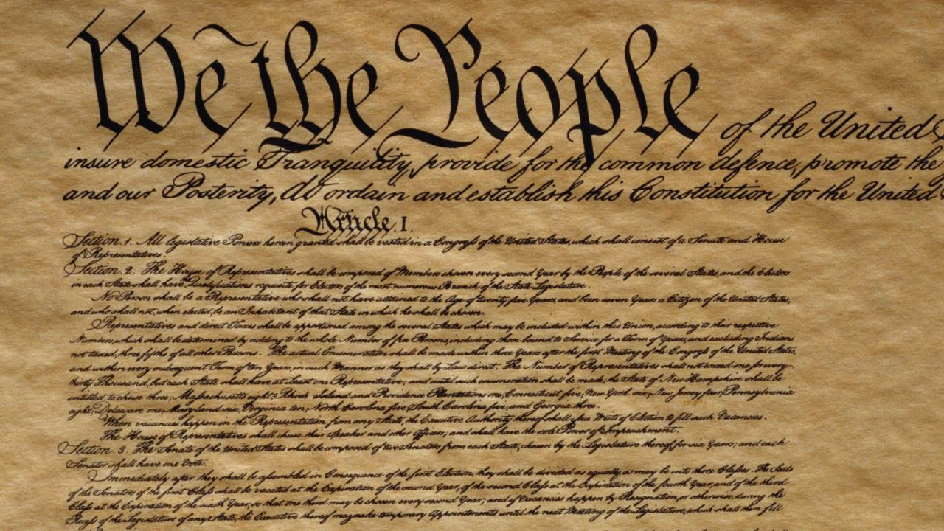
U.S. Constitution

Slide 10
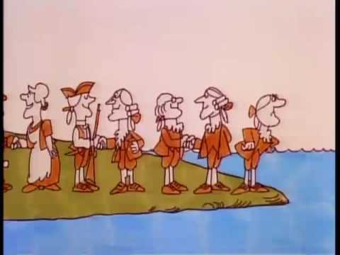
Schoolhouse Rock: No More Kings
For video click on image

Slide 11
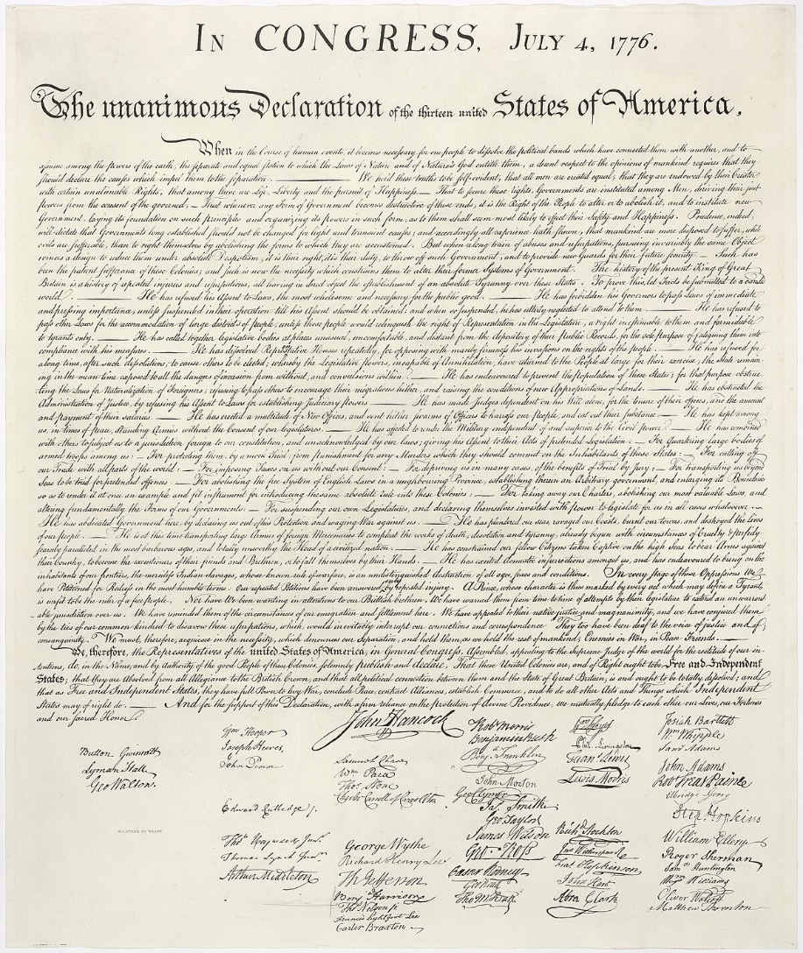
Declaration of Independence
Pronouncement adopted by the Second Continental Congress on July 4, 1776

Slide 12
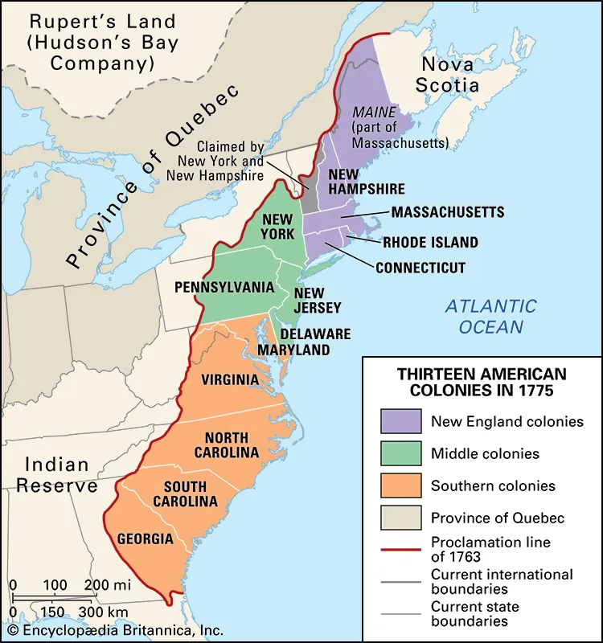
Declaration of Independence
Enacted during the American Revolution
Declaration to Great Britain of statehood and independence
  Thirteen independent sovereign states
  No longer under British rule
  Collective first step in forming the United States of America

Slide 13

“E Pluribus Unum”
“Out of many, one”
“E Pluribus Unum” - 13-letter motto of the U.S.
Out of the union of the original Thirteen Colonies emerged a new single nation

Slide 14
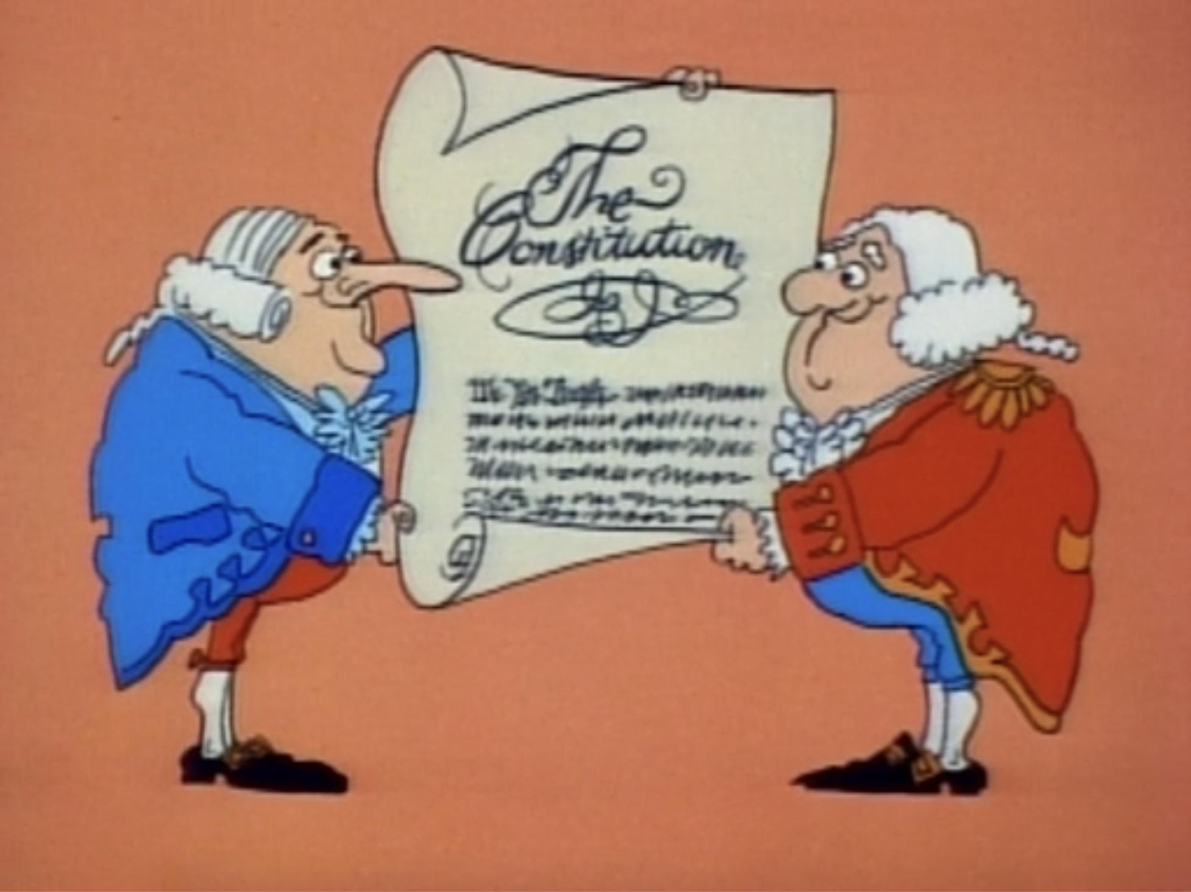
Schoolhouse Rock: The Constitution
For video click on image

Slide 15
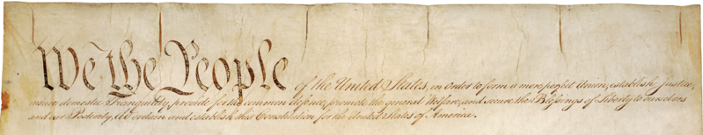
Preamble to the Constitution
We the People of the United States, in Order to form a more perfect Union, establish Justice, insure domestic Tranquility, provide for the common defence, promote the general Welfare, and secure the Blessings of Liberty to ourselves and our Posterity, do ordain and establish this Constitution for the United States of America.

Slide 16
Preamble to the Constitution
Brief introductory statement of the Constitution’s
  Fundamental purposes
  Guiding principles
Courts have referred to it as evidence of the Founding Fathers‘ intentions regarding the Constitution's meaning and what they hoped the Constitution would achieve

Slide 17
The U.S. Constitution
Created September 17, 1787
Presented September 28, 1787
Ratified June 21, 1788
Date effective March 4, 1789
Supreme Law of the United States of America

Slide 18
The U.S. Constitution
Preamble to the Constitution
The Preamble
Articles of the Constitution
Article I Legislative Branch
Article II Executive Branch
Article III Judicial Branch
Article IV Relationships Between the States
Article V Amending the Constitution
Article VI Prior Debts, National Supremacy, and Oaths of Office
Article VII Ratification

Slide 19
The U.S. Constitution
Article I, Article II, Article III
First three articles embody the doctrine of the separation of powers
Federal government is divided into three branches
  The legislative, consisting of the bicameral Congress
  The executive, consisting of the president and subordinate officers
  The judicial, consisting of the Supreme Court and other federal courts

Slide 20
The U.S. Constitution
Article IV
Relationships Between the States
Article V
Amending the Constitution
Article VI
Prior Debts, National Supremacy, and Oaths of Office
Article VII
Establishes procedure subsequently used by the 13 States to ratify

Slide 21
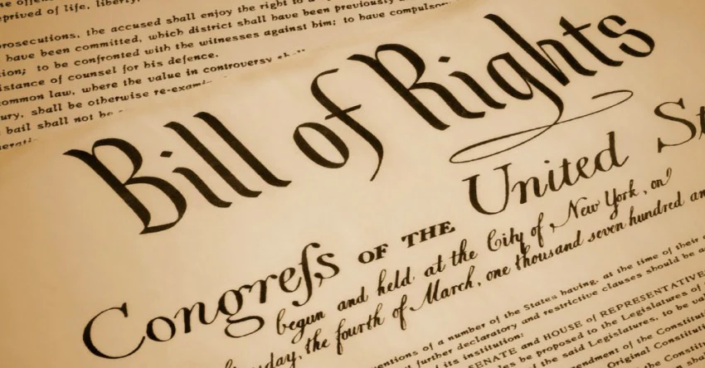
Bill of Rights
Created September 25, 1789
Ratified December 15, 1791
Update to the Constitution.
Limitation of Federal power over citizens.

Slide 22
Bill of Rights
First 10 Amendments added to the Constitution.
  Specific guarantees of personal freedoms and rights.
  Clear limitations on the government's power in judicial proceedings.
  Powers not specifically granted to the federal government by the Constitution are reserved to the states or the people.

Slide 23
Bill of Rights
First Amendment Freedom of Religion, Speech, Press, Assembly, and Petition
Second Amendment Bearing and Keeping Arms
Third Amendment Quartering Soldiers
Fourth Amendment Search and Seizure
Fifth Amendment Grand Jury, Double Jeopardy, Self Incrimination, Due Process
Sixth Amendment Rights of Those Charged in Criminal Prosecutions
Seventh Amendment Civil Trial Rights
Eighth Amendment Excessive Bail and Fines, and Cruel and Unusual Punishment
Ninth Amendment Unenumerated Rights
Tenth Amendment Rights Reserved to the States and to the People

Slide 24
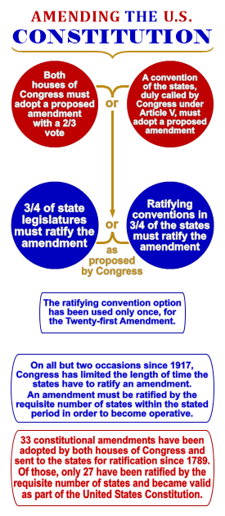
The U.S. Constitution
Amendments to the Constitution
Includes the Bill or Rights (first 10 amendments)
Total of 27 amendments

Slide 25
Amendments to the Constitution
First Amendment Freedom of Religion, Speech, Press, Assembly, and Petition
Second Amendment Bearing and Keeping Arms
Third Amendment Quartering Soldiers
Fourth Amendment Search and Seizure
Fifth Amendment Grand Jury, Double Jeopardy, Self Incrimination, Due Process, Takings
Sixth Amendment Rights of Those Charged in Criminal Prosecutions
Seventh Amendment Civil Trial Rights
Eighth Amendment Excessive Bail and Fines, and Cruel and Unusual Punishment
Ninth Amendment Unenumerated Rights
Tenth Amendment Rights Reserved to the States and to the People
Eleventh Amendment Suits Against States
Twelfth Amendment Election of President
Thirteenth Amendment Abolition of Slavery

Slide 26
Amendments to the Constitution
Fourteenth Amendment Citizenship, Equal Protection, and Other Post- Civil War Provisions
Fifteenth Amendment Right of Citizens to Vote
Sixteenth Amendment Income Tax
Seventeenth Amendment Popular Election of Senators
Eighteenth Amendment Prohibition of Liquor
Nineteenth Amendment Women's Suffrage Rights
Twentieth Amendment Presidential Term and Succession
Twenty-First Amendment Repeal of Prohibition
Twenty-Second Amendment Presidential Term Limits
Twenty-Third Amendment Presidential Electors for District of Columbia
Twenty-Fourth Amendment Abolition of the Poll Taxes
Twenty-Fifth Amendment Presidential Vacancy and Disability
Twenty-Sixth Amendment Reduction of Voting Age
Twenty-Seventh Amendment Congressional Compensation

Slide 27

Amendment XIV
Why the 14th Amendment is one of history’s most important and radical ideas.
For video click on image

Slide 28
Amendment XIV
Section 1.
All persons born or naturalized in the United States, and subject to the jurisdiction thereof, are citizens of the United States and of the state wherein they reside. No state shall make or enforce any law which shall abridge the privileges or immunities of citizens of the United States; nor shall any state deprive any person of life, liberty, or property, without due process of law; nor deny to any person within its jurisdiction the equal protection of the laws.

Slide 29
Amendment XIV
Section 2.
Representatives shall be apportioned among the several states according to their respective numbers, counting the whole number of persons in each state, excluding Indians not taxed. But when the right to vote at any election for the choice of electors for President and Vice President of the United States, Representatives in Congress, the executive and judicial officers of a state, or the members of the legislature thereof, is denied to any of the male inhabitants of such state, being twenty-one years of age, and citizens of the United States, or in any way abridged, except for participation in rebellion, or other crime, the basis of representation therein shall be reduced in the proportion which the number of such male citizens shall bear to the whole number of male citizens twenty-one years of age in such state.

Slide 30
Amendment XIV
Section 3.
No person shall be a Senator or Representative in Congress, or elector of President and Vice President, or hold any office, civil or military, under the United States, or under any state, who, having previously taken an oath, as a member of Congress, or as an officer of the United States, or as a member of any state legislature, or as an executive or judicial officer of any state, to support the Constitution of the United States, shall have engaged in insurrection or rebellion against the same, or given aid or comfort to the enemies thereof. But Congress may by a vote of two-thirds of each House, remove such disability.

Slide 31
Amendment XIV
Section 4.
The validity of the public debt of the United States, authorized by law, including debts incurred for payment of pensions and bounties for services in suppressing insurrection or rebellion, shall not be questioned. But neither the United States nor any state shall assume or pay any debt or obligation incurred in aid of insurrection or rebellion against the United States, or any claim for the loss or emancipation of any slave; but all such debts, obligations and claims shall be held illegal and void.

Slide 32
Amendment XIV
Section 5.
The Congress shall have power to enforce, by appropriate legislation, the provisions of this article.

Slide 33
Amendment XIV
Number of important concepts, most famously Section 1.
State Action - State cannot make or enforce any law that abridges the privileges or immunities of any citizen.
Privileges and Immunities – Protection of interstate travel.
Citizenship – US & state citizenship to all born in the United States.
Due Process – State must respect all legal rights that are owed to a person.
Equal Protection - Individuals in similar situations treated equally by the law.

Slide 34
Amendment XIV
Other important concepts:
Section Two - Apportionment of representatives to Congress. Penalizes states that denied voting to males 21 and older (other for than crime).
Section Three - Participates in “insurrection or rebellion” against the United States shall not hold federal office.
Section Four – Repudiation of debts accrued by the Confederacy and federal debt for services against insurrection are sacrosanct.
Section Five - Expressly authorizes Congress to enforce the Fourteenth Amendment “by appropriate legislation.”

Slide 35
Requirement 1 Review
What is the Constitution of the United States?
What does the Constitution do?
What principles does it reflect?
Why is it important to have a Constitution?

Slide 36
Requirement 2
List the six purposes for creating the United States Constitution set forth in the Preamble to the Constitution. How do these purposes affect your family and community?

Slide 37
Government
Six Functions of Government
  Preamble to the Constitution
We the People of the United States, in Order to form a more perfect Union, establish Justice, insure domestic Tranquility, provide for the common defence, promote the general Welfare, and secure the Blessings of Liberty to ourselves and our Posterity, do ordain and establish this Constitution for the United States of America.

Slide 38
Government
Six Functions of Government:
  Form a more perfect union.
  Establish justice.
  Insure domestic tranquility.
  Provide for the common defense.
  Promote the general welfare.
  Secure the blessings of liberty to ourselves and our posterity.

Slide 39
Requirement 3
List the three branches of the United States government. Explain:
  The function of each branch of government
  Why it is important to divide powers among different branches
  How each branch "checks" and "balances" the others
  How citizens can be involved in each branch of government.

Slide 40
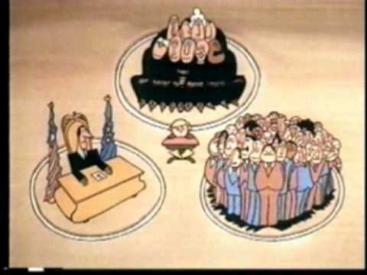
Schoolhouse Rock: Three Branches of Government
For video click on image

Slide 41
Three Branches of Government
Legislative Branch
The legislative branch is made up of the House and Senate, known collectively as the Congress
Among other powers, the legislative branch:
  Makes all laws.
  Declares war.
  Regulates interstate and foreign commerce.
  Controls taxing and spending policies.

Slide 42
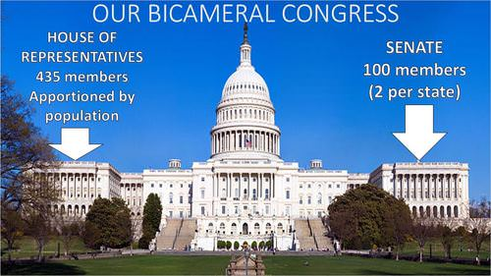
Three Branches of Government
Legislative Branch
The House of Representatives
  Based on population
The Senate
  Two per State

Slide 43
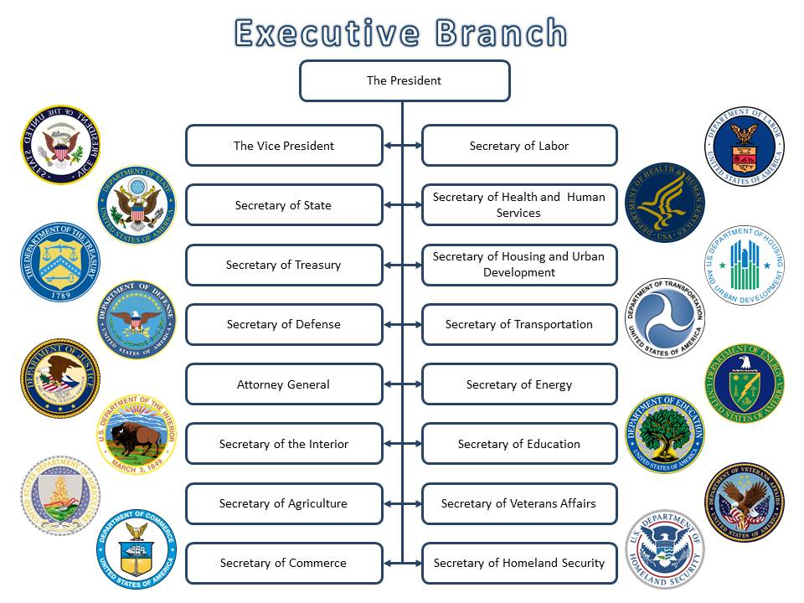
Three Branches of Government
Executive Branch
The executive branch consists of the President, his or her advisors and various departments and agencies
This branch is responsible for enforcing the laws of the land.

Slide 44
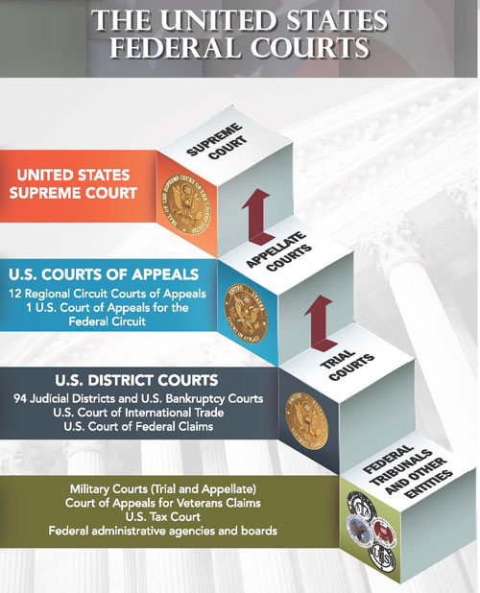
Three Branches of Government
Judicial Branch
According to the Constitution, “The judicial Power of the United States, shall be vested in one supreme Court, and in such inferior Courts as the Congress may from time to time ordain and establish."

Slide 45
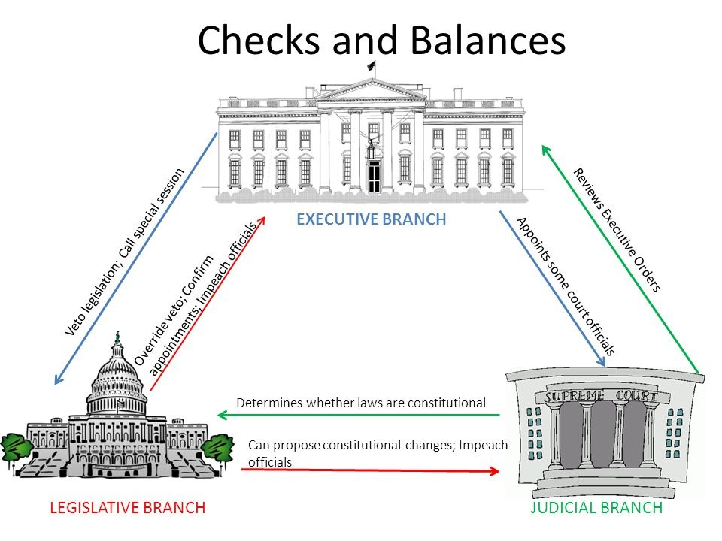
U.S. Government

Slide 46
Requirement 5
Watch the national evening news for five days in a row or read the main stories in a national media organization (e.g., a newspaper or news website) for five days in a row. Discuss the national issues that you learned about with your counselor. Choose one issue and explain how it affects you, your family, and community.

Slide 47



Current National Events
National Evening News
ABC World News
CBS Evening News
NBC Nightly News

Slide 48
Requirement 6
With your counselor's approval, choose a speech of national historical importance.
Explain:
  Who the author was
  What the historical context was
  What difficulties the nation faced that the author wished to discuss
  What the author said
  Why the speech is important to the nation's history.
Choose a sentence or two from the speech that has significant meaning to you, and tell your counselor why.

Slide 49
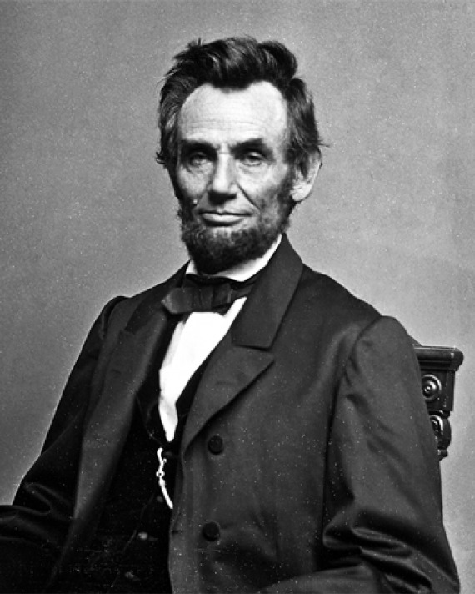
Gettysburg Address
President Lincoln:
  American lawyer and statesman.
  16th president of the United States.
  Led the nation through the American Civil War.
  Succeeded in:
    Preserving the Union.
    Abolishing slavery.
    Bolstering the federal government.
    Modernizing the U.S. economy.

Slide 50
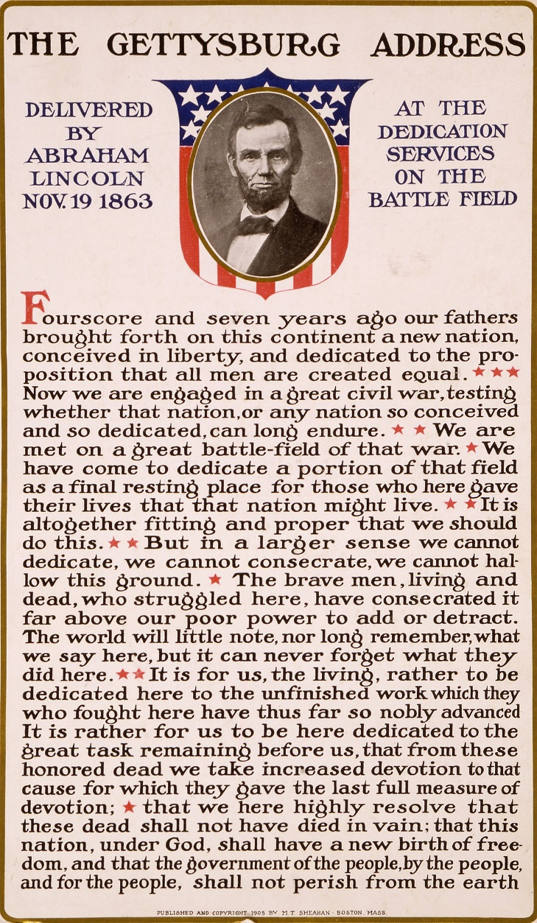
Gettysburg Address
President Abraham Lincoln November 19, 1863
4.5 months following Battle of Gettysburg

Slide 51
Gettysburg Address
President Lincoln described the US as a nation "conceived in Liberty, and dedicated to the proposition that all men are created equal,“
Honored the sacrifices of those who died at Gettysburg in defense of those principles:
  “that these dead shall not have died in vain—that this nation, under God, shall have a new birth of freedom—and that government of the people, by the people, for the people, shall not perish from the earth”

Slide 52
Important Historical Speeches
Martin Luther King Jr.’s “I Have a Dream” speech in which he calls for an end to segregation and racial discrimination.
Franklin Delano Roosevelt’s speech one day after the bombing of Pearl Harbor, asking Congress to declare war on Japan.
Ronald Reagan’s “Tear Down This Wall” speech that challenged Communist leaders to end the Cold War and foster peace between West and East Germany.
List of Famous American Speeches.

Slide 53
Requirement 7
Do TWO of the following:
  Visit a place that is listed as a National Historic Landmark or that is on the National Register of Historic Places. Tell your counselor what you learned about the landmark or site and what you found interesting about it.
  Tour your state capitol building or the U.S. Capitol. Tell your counselor what you learned about the capitol, its function, and the history.
  Tour a federal facility. Explain to your counselor what you saw there and what you learned about its function in the local community and how it serves this nation.
  Choose a national monument that interests you. Using books, brochures, the internet (with your parent's permission), and other resources, find out more about the monument. Tell your counselor what you learned, and explain why the monument is important to this country's citizens.

Slide 54


National Historical Landmark
National Historical Landmarks by State
National Register of Historical Places

Slide 55
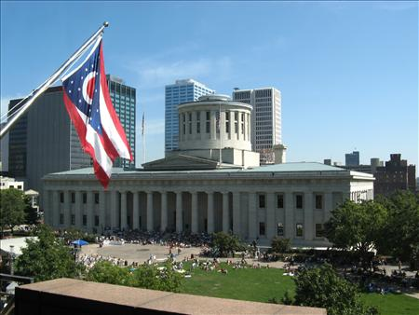
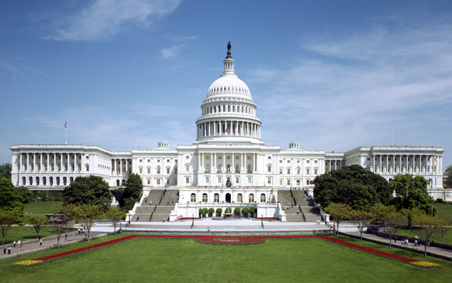
State or U.S. Capitol
Ohio Capitol Building
U.S. Capitol Building

Slide 56
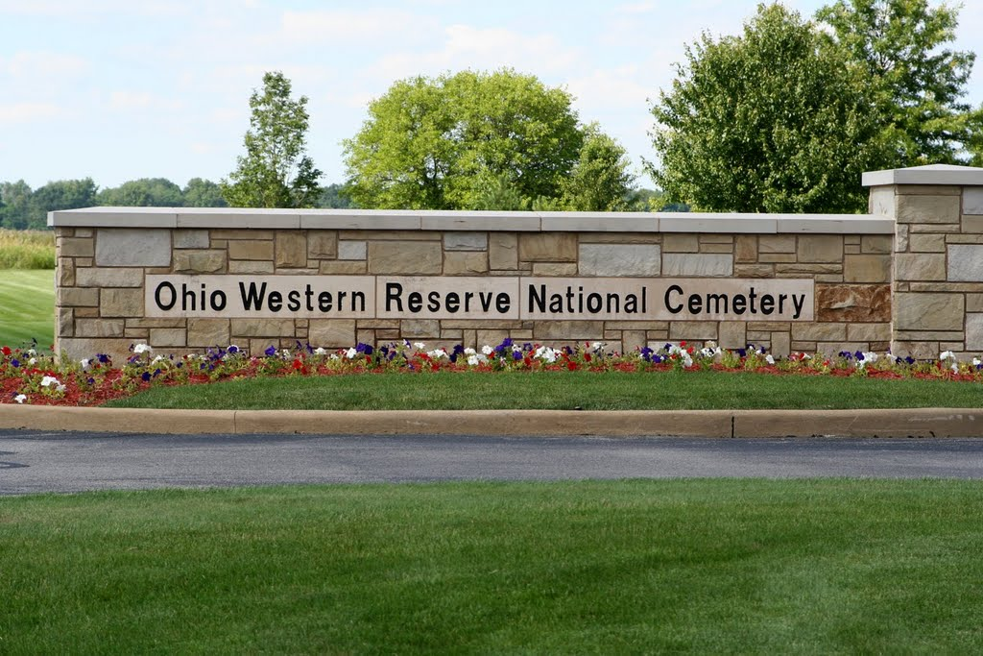

Federal Facility
Federal Offices Serving Ohio
Federal Buildings in Ohio

Slide 57
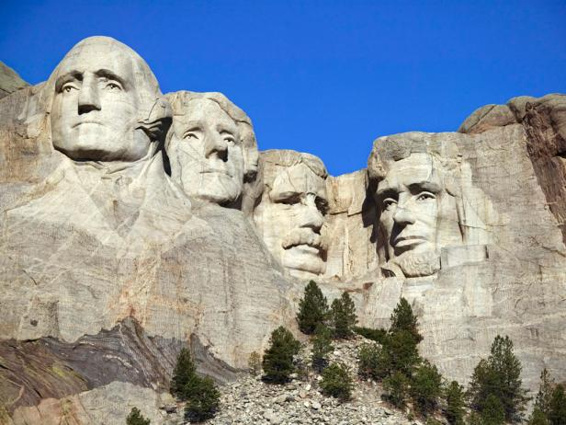
National Monument
List of National Monuments in the U.S.

Slide 58
Requirement 8
Name your representatives in the United States Congress. Write a letter to your representative in Congress explaining your views on a national issue. Show your letter, along with any response you might receive, to your counselor.

Slide 59
U.S. Senators
Each state in the United States elects two senators.
  List of U.S. Senators
This allows for equal representation regardless of the State’s size or population.
Senators serve six-year terms with staggered elections.

Slide 60
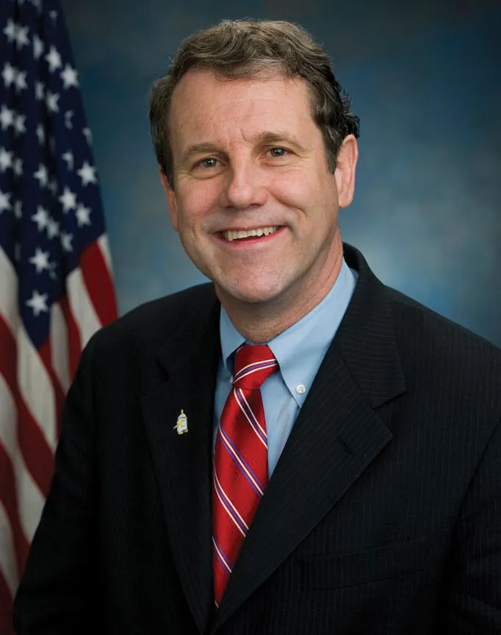

Ohio Senators
Sharrod Brown
J.D. Vance

Slide 61
U.S. Representatives
The United States is divided into 435 congressional districts (see map)
Each district has a population of about 710,000 individuals.
Each district elects a representative (congressmen/congresswomen) to the House of Representatives for a two-year term.
Americans in the United States’ six territories are represented in the House of Representatives by an additional six non-voting delegates.

Slide 62
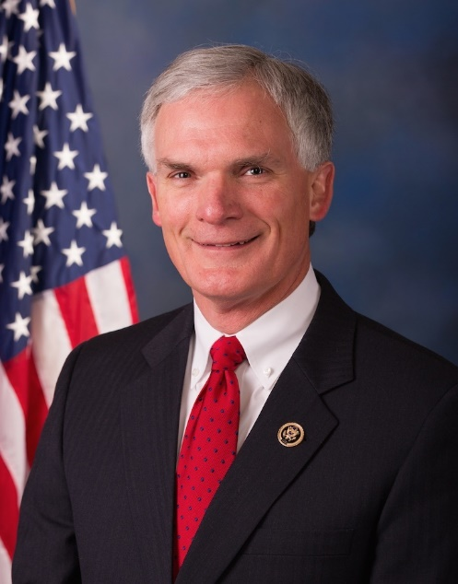

Representatives for Ohio
5th District (includes Wood County)
4th District (includes Sandusky County)
Robert Latta
Jim Jordan

Slide 63
Contact a Senator or Representative
Senators
  www.senate.gov/senators/senators-contact.htm
Representatives
  www.house.gov/representatives

Slide 64
Writing an Effective Letter
Address the official using his or her correct title.
  U.S. Senator:
    The address: The Honorable John Smith,
    The greeting: Dear Senator Smith,
  Member of the House of Representatives:
    The address: The Honorable Mary Doe,
    The greeting: Dear Ms. Doe,

Slide 65
Writing an Effective Letter
Identify yourself and your reasons for writing the letter.
Refer to a specific bill by number or name, if applicable.
Explain briefly, rationally and politely why are you concerned about the issue?
Send your letter before the bill is brought to the floor or while your representative can still do something about your concern.
Request a response and include your return address.

Slide 66
Final Thoughts
Our Nation was built and shaped by those in it.
You impact the success or failure of your Nation.
Participate.
Be a good Citizen.

Slide 67
Final Thoughts
Merit Badge Requirement Checklist
❑ Show completion of work (turn in complete
worksheet)
❑ Req 1 – Constitution
❑ Req 2 – Preamble to the Constitution
❑ Req 3 – 3 Branches of Government
❑ Req 4 – Important Documents
❑ Req 5 – National News
❑ Req 6 – Important Speech
❑ Req 7 – Field Trip
❑ Req 8 – Contact an Elected Official

